Slide 1

Fall 2016
Senior Software Engineering Project
Nucor-Relay for Life Website

Slide 2
Sprint 1 & 2 Completed!
Static Development
01.
Feature Development
Static development and templating
ONE
Testing & Delivery
TWO
02.
THREE
Database development and integration with site
03.
Testing, feature wrap up, delivery of product and documentation

Slide 3

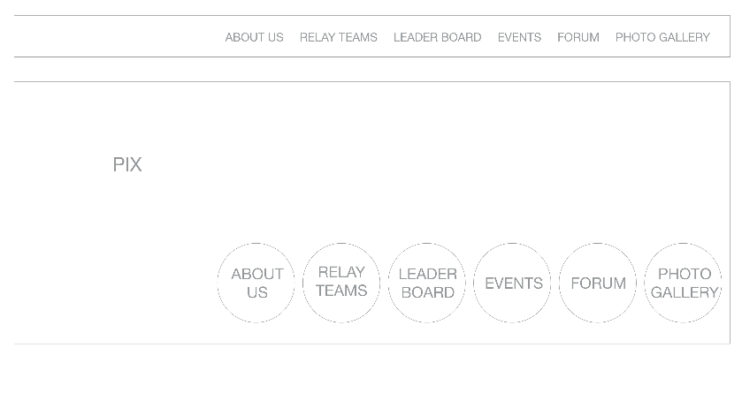
WIREFRAME: Complete
Home
The wireframe is the key foundation to build upon in order to achieve overall usability of your website

Slide 4
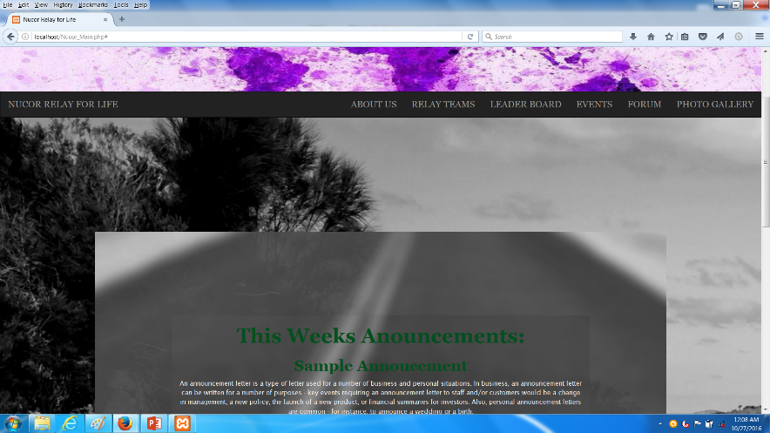
Home: Completed
Home:
Weekly Announcements and Daily Events displayed from the database.

Slide 5
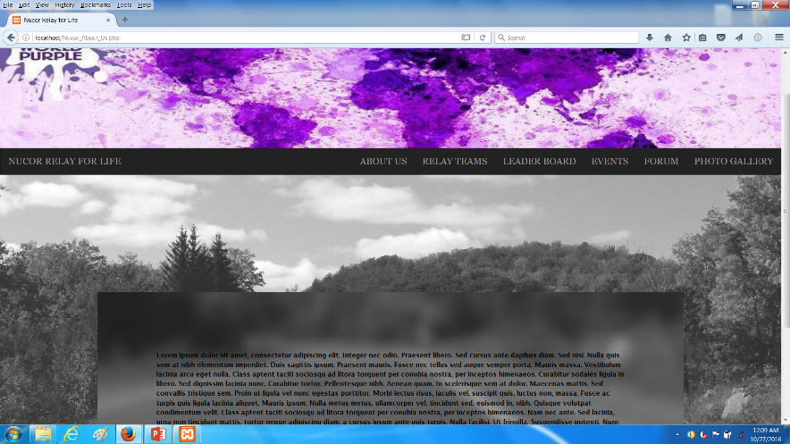
About Us: Completed
About Us: The mission statement and information about the client’s goal. To be provided by the client.

Slide 6
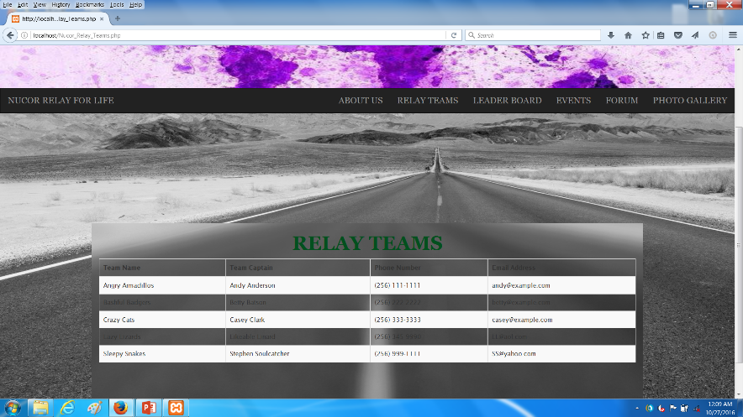
Relay Teams: Completed
Relay Teams: Dynamic tables and content now provided by the database.

Slide 7
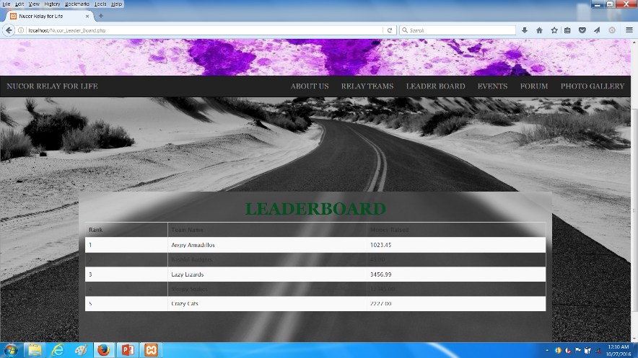
Leader Board: Completed
Leaderboard: Dynamic and calculated on access.

Slide 8
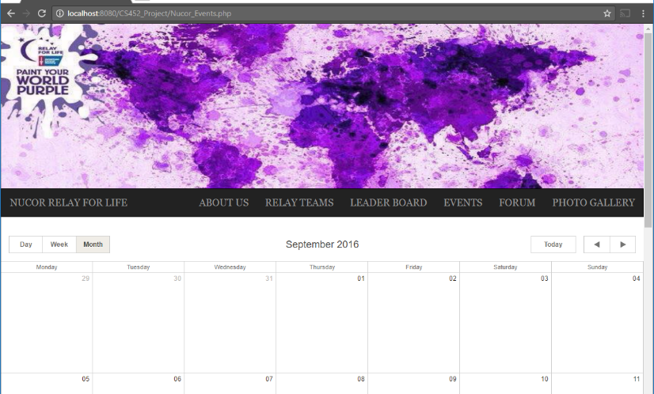
Outdated Events Page
Event calendar:
What Changed? This calendar presented during the first sprint had performance issues and was changed to maximize efficiency.

Slide 9
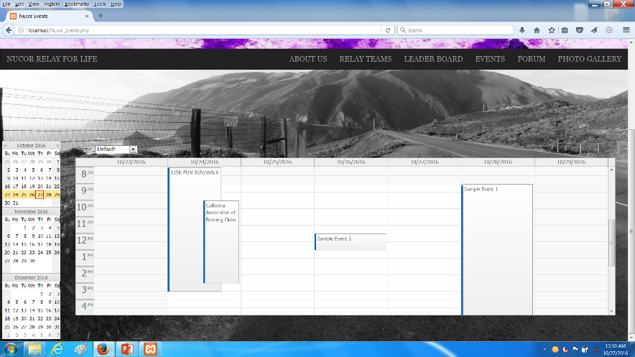
New Event Calendar: Completed
New Event Calendar:
Administrator Editable
User Friendly
Sharp New Look!

Slide 10
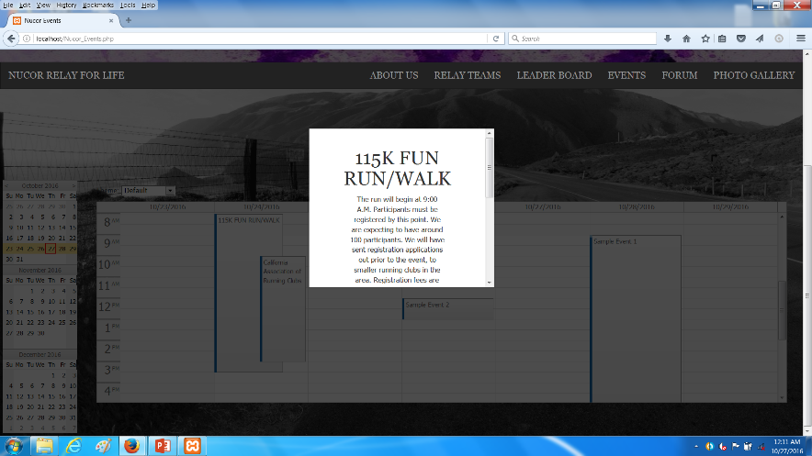
Events: Completed
New Event Calendar:
Event Details Displayed
Start and End Times Shown of Events upon clicking on them.

Slide 11
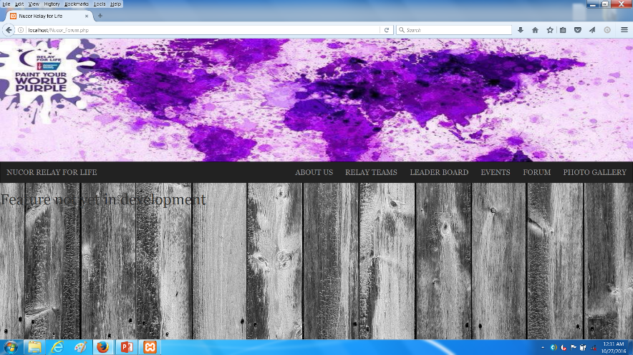
Status of the Forum
Forum: Due to security and feature development concerns, this site portion will be beyond the scope of this project.

Slide 12
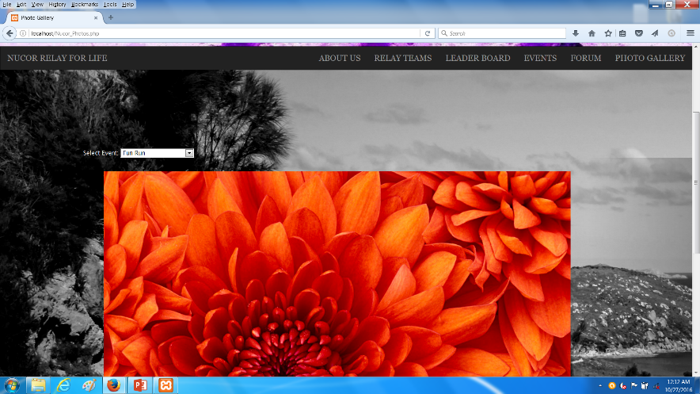
Photo Gallery: Completed
Gallery:
Images can be changed by the administrator.
Client side selectable event albums for wider picture organization

Slide 13
Behind the Scenes Work
1.
The client side will send a request to the server using JavaScript and data it has collected.
Client
2.
PHP server side takes that request and queries the database based upon the client needs
Server
3.
Data is sent back from the database to the server side PHP where HTML is generated and sent back to the client
Database

Slide 14
Data Base ER-Diagram
*Database is still under active development
MySQL NUCORE database
Tables Developed Include:
Login
Events
Images
Leader Board
Labels
Teams
.

Slide 15
Sprint!
Static Development
01.
Feature Development
Static development and templating:
Completed!
ONE
Testing & Delivery
TWO
02.
THREE
Database development and integration with site
Completed!
03.
Administrative website, testing, feature wrap up, delivery of product and documentation

Slide 16

THANK YOU FOR YOUR TIME
We look forward to our continued collaboration effort with Nucor and the next presentation!
-The Fall 2016 CS452 Team

